Slide 1
Agricultural Goods exported in US states
By Purnasree Saha, Yamini Pathuri, and Koundinya Raghava Nerella
Instructor: Dr. Jiayin Wang
Project 2: Map and Aggregation Visualization
CSIT553_01SP22 - Exploratory Data Analysis and Visualization
Montclair State University, NJ

Slide 2
Description of the Dataset:
The data set consists of export value of agricultural products of each state of United states for the year 2011.
The export value for 13 types of products are mentioned in the data along with the total export value of each state.
Dataset Citation:
https://github.com/plotly/datasets/blob/master/2011_us_ag_exports.csv

Slide 3
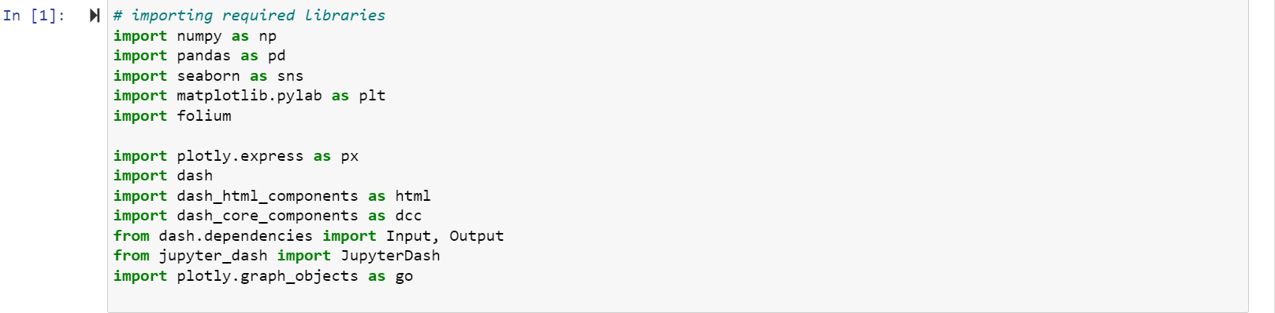
Importing necessary Libraries:

Slide 4
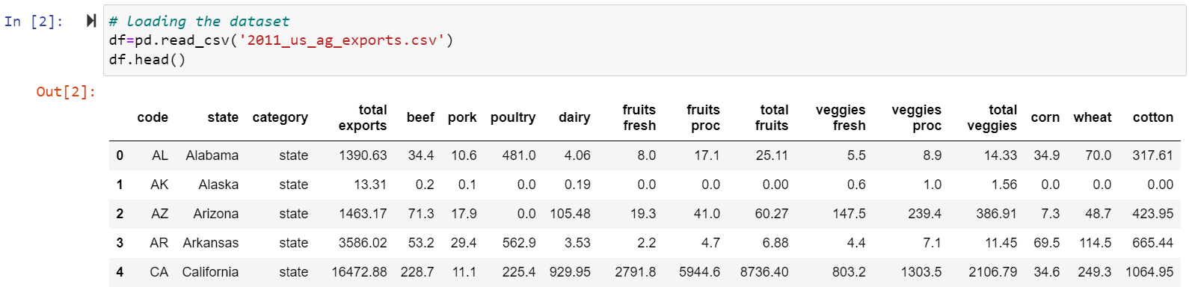
Data Loading:

Slide 5
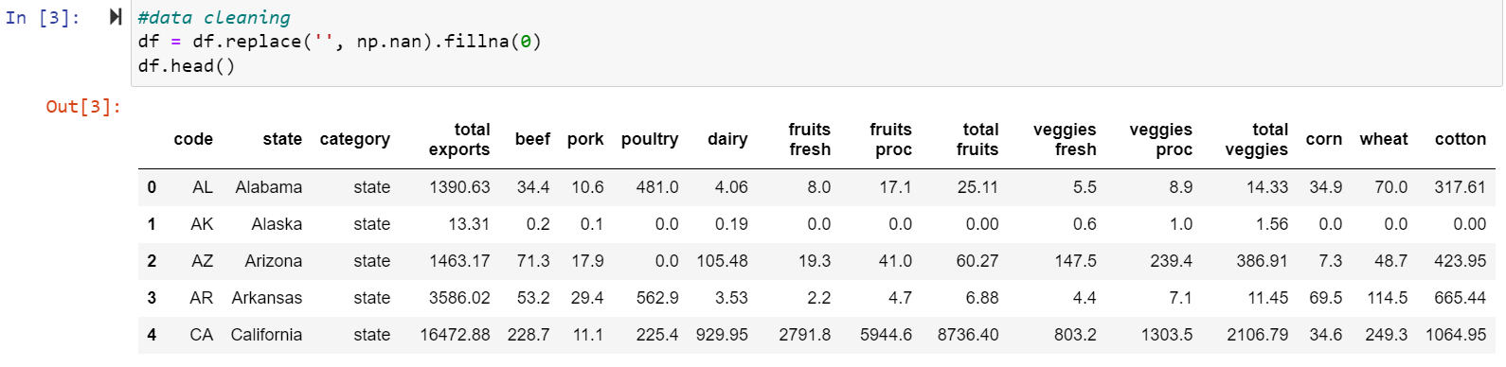
Data Cleaning:

Slide 6
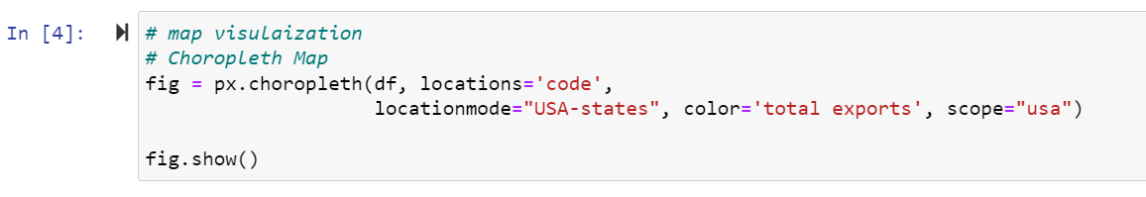
Map Visualization - Choropleth Map
The total export value of each state is being visualized using a ‘Choropleth map’

Slide 7
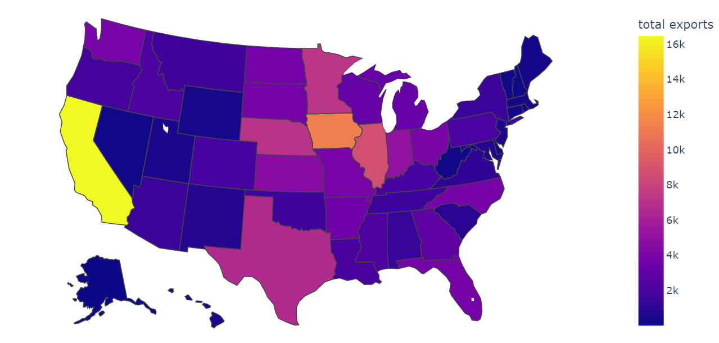
The total export value of each state could be found out by hovering the mouse over the state. A spectrum of color from blue to yellow distinguishes the value of total exports from low to high. As per the above map the California state has the highest total export value.

Slide 8
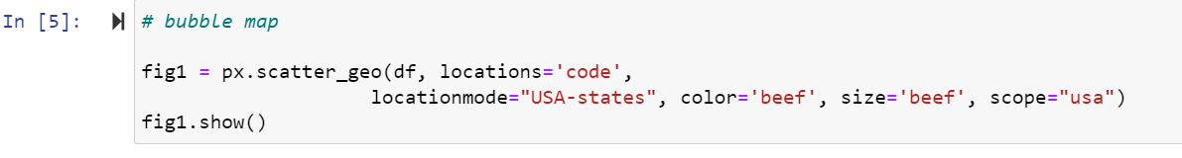
Map Visualization - Bubble Map
The ‘export value of ‘beef’ for each state is visualized using a ‘Bubble map’

Slide 9
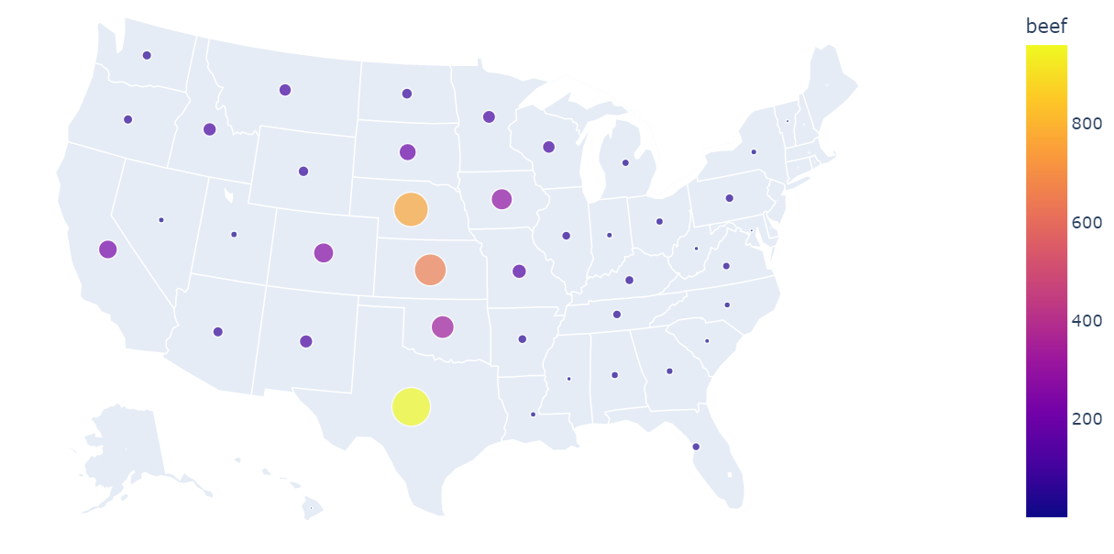
The export value of beef for each state can be studied from the above map. The map signifies that the Texas has the highest export value of beef.

Slide 10
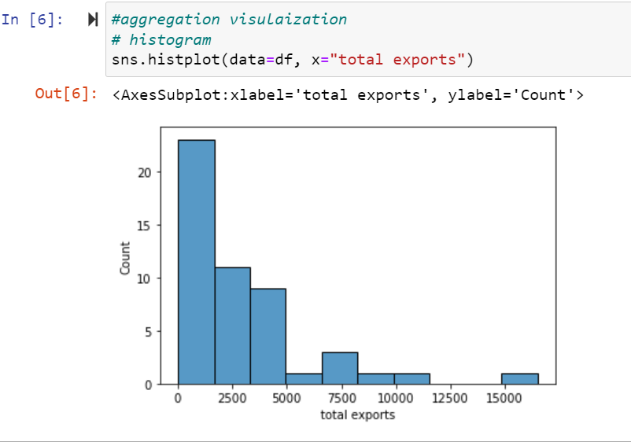
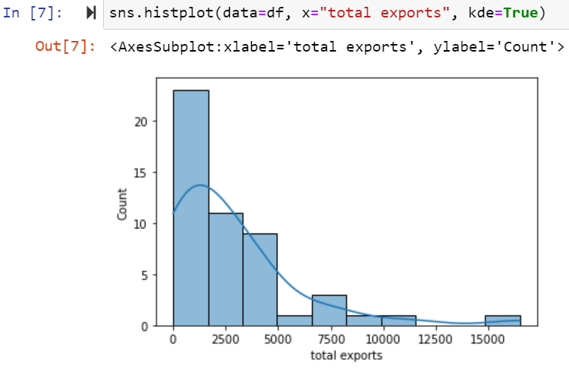
Aggregation Visualization - Histogram
There are two histogram plots that are shown for the total number of exported goods in USA and the second plot shows the kernel density estimation.

Slide 11
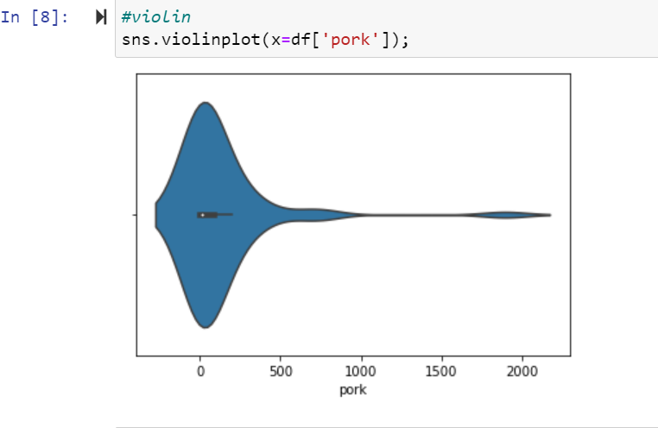
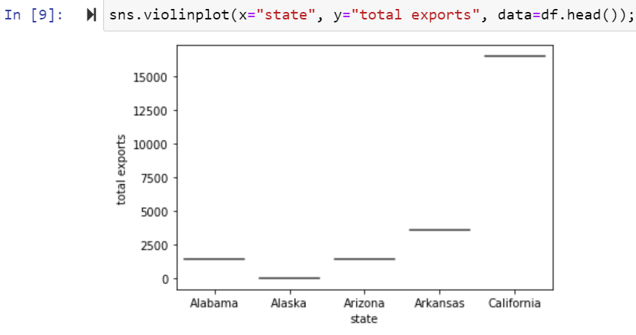
Aggregation Visualization: Violin plot

Slide 12
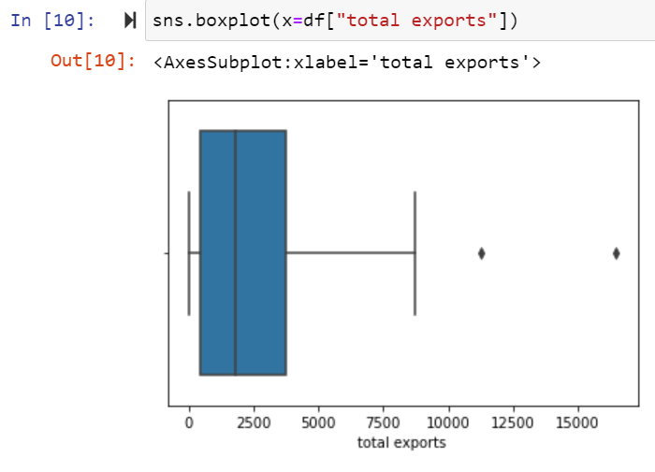
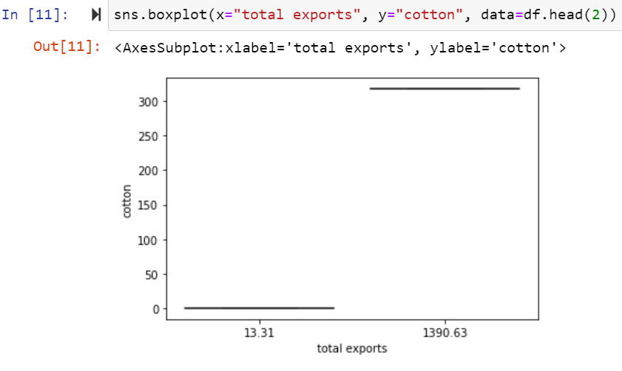
Box Plot:

Slide 13
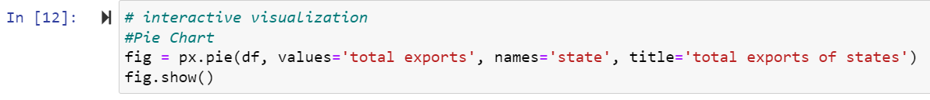
Interactive visualization - Pie chart
The percentage of total exports of each state is visualized using ‘pie chart’

Slide 14
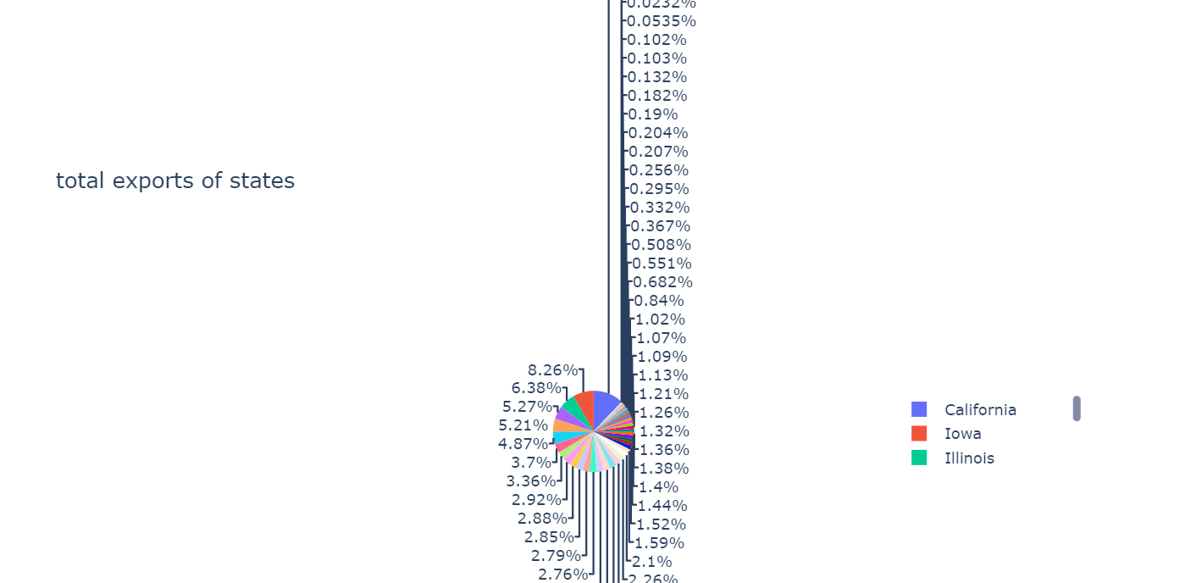
From the above chart excluding the states that have low ‘total exports’ to make the data more readable and meaningful

Slide 15

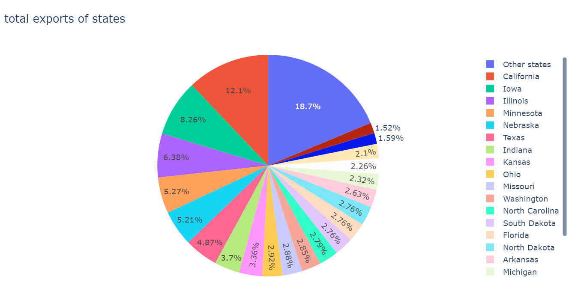

Slide 16
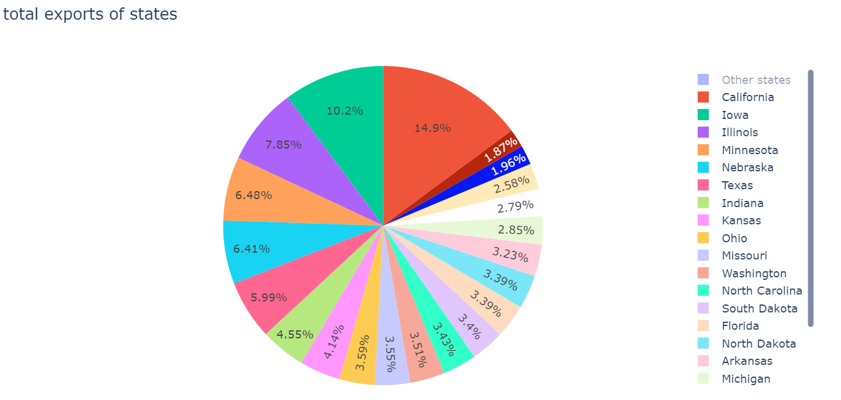
From the earlier chart, ‘other states’ are deselected, so that the data is visualized only for the majorly contributing states. As per the updated graph California shares the major part with 14.9% followed by Iowa with 10.2%.

Slide 17
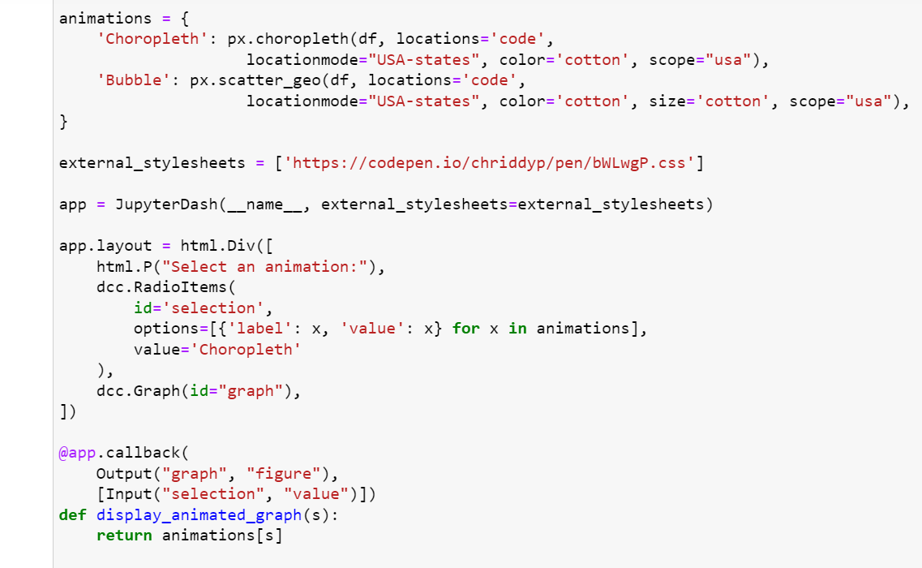
Interactive Visualization - Map Visualization

Slide 18
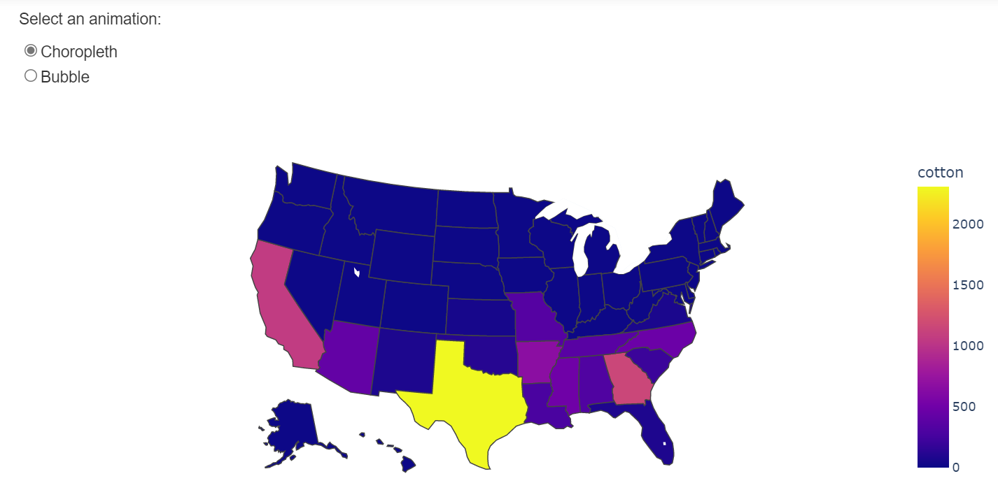
We have generated both choropleth map and bubble map for ‘cotton exports’ simultaneously with a radio button option to switch between the maps using animated figures in dash.

Slide 19
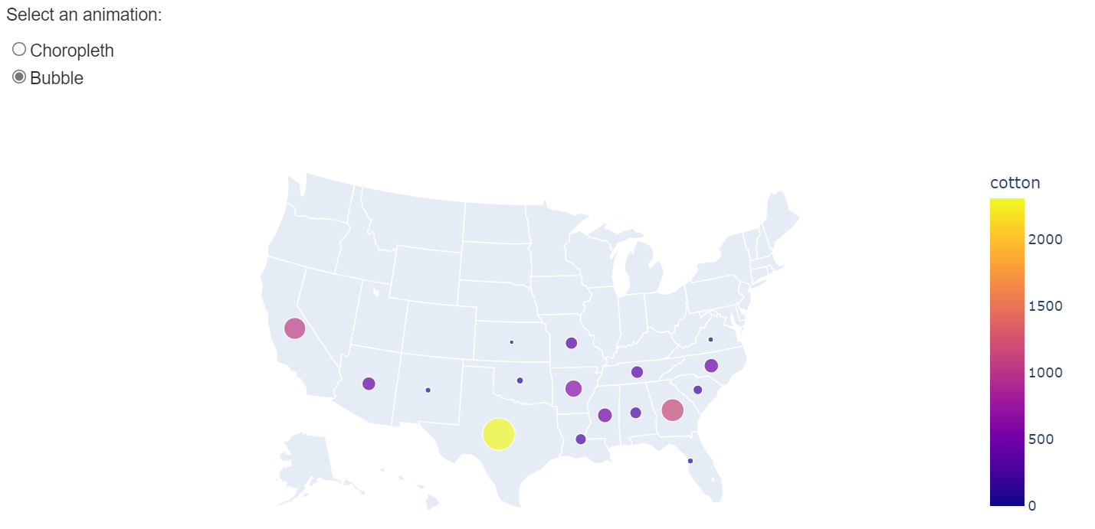
The above two maps depicts that the Texas has the highest export value for ‘Cotton’.

Slide 20


